Slide 1
Deep Learning & Feature Learning
Methods for Vision
CVPR 2012 Tutorial: 9am-5:30pm
Rob Fergus (NYU)
Kai Yu (Baidu)
Marc’Aurelio Ranzato (Google)
Honglak Lee (Michigan)
Ruslan Salakhutdinov (U. Toronto)
Graham Taylor (University of Guelph)

Slide 2
Tutorial Overview
9.00am: Introduction Rob Fergus (NYU)
10.00am: Coffee Break
10.30am: Sparse Coding Kai Yu (Baidu)
11.30am: Neural Networks Marc’Aurelio Ranzato (Google)
12.30pm: Lunch
1.30pm: Restricted Boltzmann Honglak Lee (Michigan) Machines
2.30pm: Deep Boltzmann Ruslan Salakhutdinov (Toronto) Machines
3.00pm: Coffee Break
3.30pm: Transfer Learning Ruslan Salakhutdinov (Toronto)
4.00pm: Motion & Video Graham Taylor (Guelph)
5.00pm: Summary / Q & A All
5.30pm: End

Slide 3
Overview
Learning Feature Hierarchies for Vision
Mainly for recognition
Many possible titles:
Deep Learning
Feature Learning
Unsupervised Feature Learning
This talk: Basic concepts Links to existing vision approaches

Slide 4
Existing Recognition Approach
Hand-designed Feature Extraction
Trainable Classifier
Image/Video
Pixels
Object Class
Features are not learned
Trainable classifier is often generic (e.g. SVM)
Slide: Y.LeCun

Slide 5
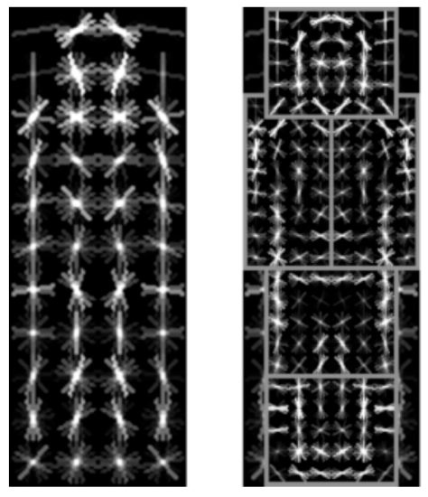
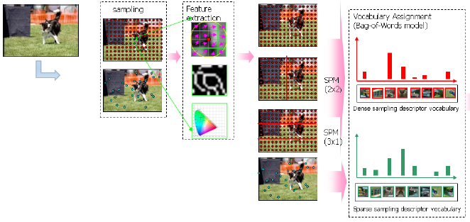

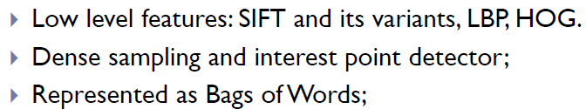
Motivation
Features are key to recent progress in recognition
Multitude of hand-designed features currently in use
SIFT, HOG, LBP, MSER, Color-SIFT………….
Where next? Better classifiers? Or keep building more features?
Felzenszwalb, Girshick, McAllester and Ramanan, PAMI 2007
Yan & Huang (Winner of PASCAL 2010 classification competition)

Slide 6
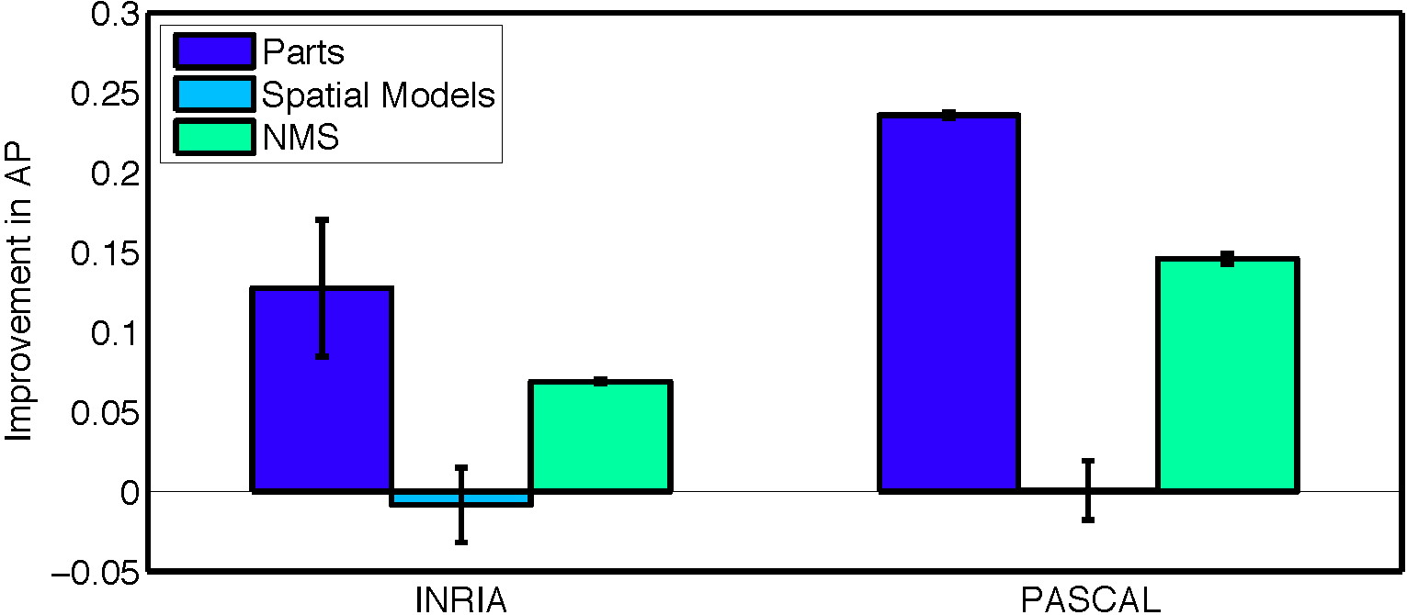
What Limits Current Performance?
Ablation studies on Deformable Parts Model
Felzenszwalb, Girshick, McAllester, Ramanan, PAMI’10
Replace each part with humans (Amazon Turk):
Also removal of part deformations has small (<2%) effect. Are “Deformable Parts” necessary in the Deformable Parts Model? Divvala, Hebert, Efros, Arxiv 2012
Parikh & Zitnick, CVPR’10

Slide 7
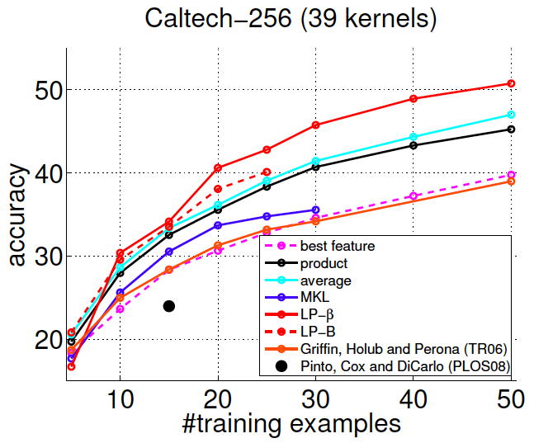
Hand-Crafted Features
LP-β Multiple Kernel Learning
Gehler and Nowozin, On Feature Combination for Multiclass Object Classification, ICCV’09
39 different kernels
PHOG, SIFT, V1S+, Region Cov. Etc.
MKL only gets few % gain over averaging features
→ Features are doing the work

Slide 8

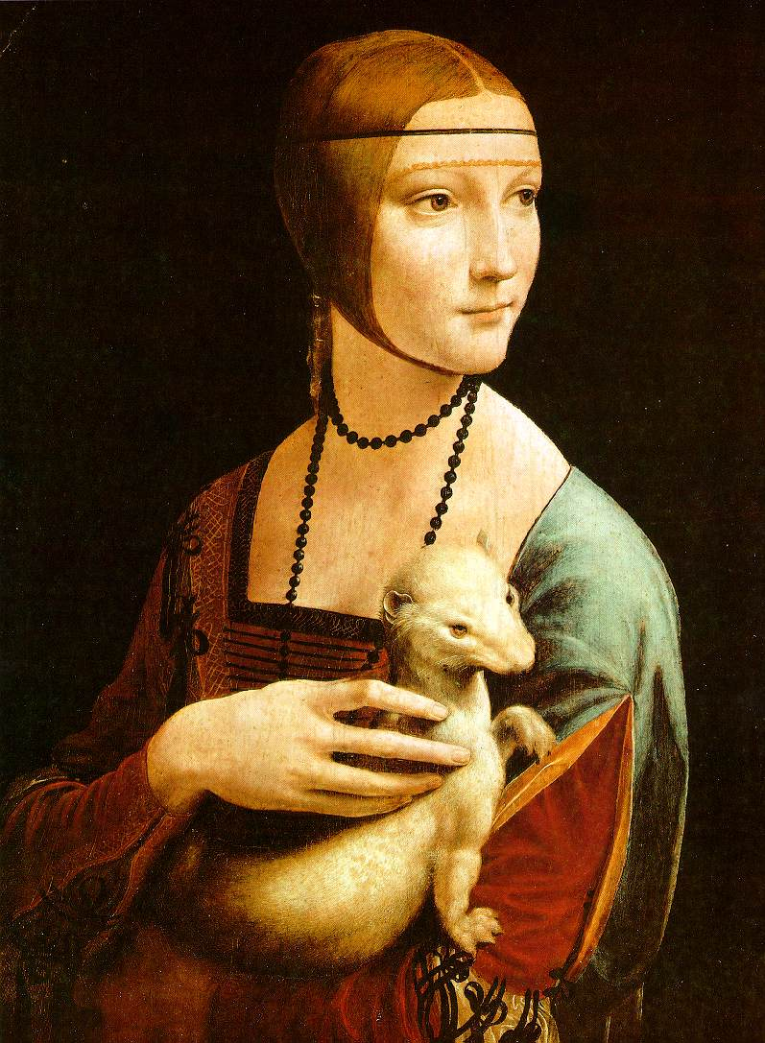
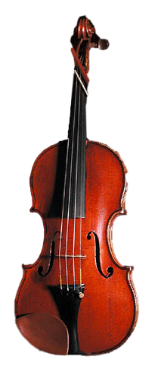
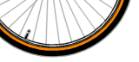
Mid-Level Representations
Mid-level cues
Continuation
Parallelism
Junctions
Corners
“Tokens” from Vision by D.Marr:
Object parts:
Difficult to hand-engineer → What about learning them?

Slide 9
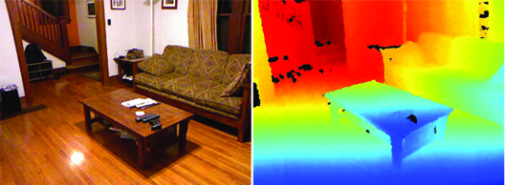
Why Learn Features?
Better performance
Other domains (unclear how to hand engineer):
Kinect
Video
Multi spectral
Feature computation time
Dozens of features now regularly used
Getting prohibitive for large datasets (10’s sec /image)

Slide 10
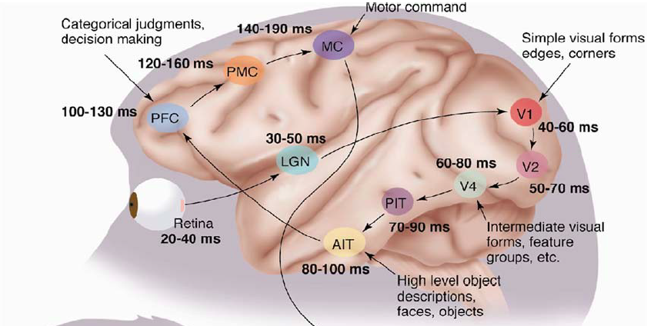
Why Hierarchy?
Theoretical:
“…well-known depth-breadth tradeoff in circuits design [Hastad 1987]. This suggests many functions can be much more efﬁciently represented with deeper architectures…” [Bengio & LeCun 2007]
Biological: Visual cortex is hierarchical
[Thorpe]
Notes:
All I am going to say about Neuroscience, although techniques do have strong connections.

Slide 11
Hierarchies in Vision
Spatial Pyramid Matching
Lazebnik et al. CVPR’06
2 layer hierarchy
Spatial Pyramid Descriptor pools VQ’d SIFT
Classifier
Spatial Pyramid Descriptor
SIFT Descriptors
Image

Slide 12
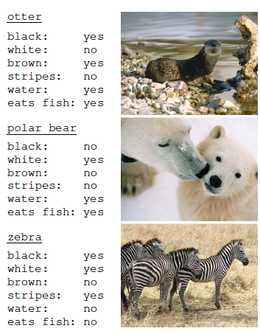
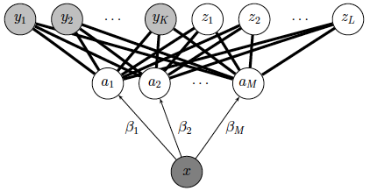
Hierarchies in Vision
Lampert et al. CVPR’09
Learn attributes, then classes as combination of attributes
Class Labels
Attributes
Image Features

Slide 13
Learning a Hierarchy of Feature Extractors
Each layer of hierarchy extracts features from output of previous layer
All the way from pixels → classifier
Layers have the (nearly) same structure
Image/Video
Pixels
Layer 1
Layer 2
Layer 3
Simple Classifier
Train all layers jointly
Notes:
Make clear that classic methods, e.g. convnets are purely supervised.

Slide 14
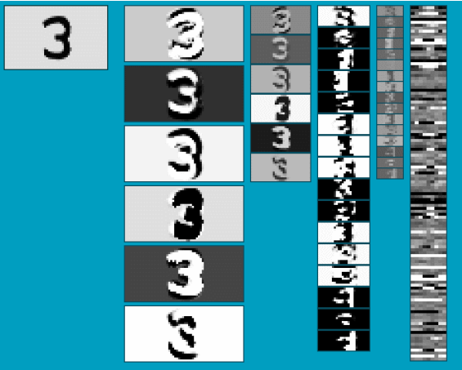
Multistage Hubel­Wiesel Architecture
Stack multiple stages of simple cells / complex cells layers
Higher stages compute more global, more invariant features
Classification layer on top
History:
Neocognitron [Fukushima 1971-1982]
Convolutional Nets [LeCun 1988-2007]
HMAX [Poggio 2002-2006]
Many others…
QUESTION: How do we find (or learn) the filters?
Slide: Y.LeCun
Notes:
Need to bring out differeces wrt to existing ML stuff, mainly unsupervised learning part. Make use of unlabaled data (lots of it).

Slide 15
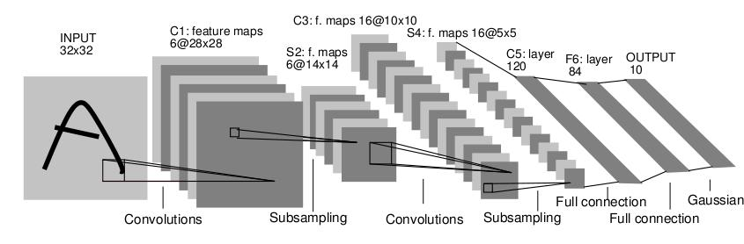
Classic Approach to Training
Supervised
Back-propagation
Lots of labeled data
E.g. Convolutional Neural Networks
Problem:
Difficult to train deep models (vanishing gradients)
Getting enough labels
[LeCun et al. 1998]
Notes:
Restructure to bigger emphasis on unsupervised.
Make clear that classic methods, e.g. convnets are purely supervised.

Slide 16
Deep Learning
Unsupervised training
Model distribution of input data
Can use unlabeled data (unlimited)
Refine with standard supervised techniques (e.g. backprop)

Slide 17
Single Layer Architecture
Input: Image Pixels / Features
Layer n
Filter
Not an exact separation
Details in the boxes matter
(especially in a hierarchy)
Normalize
Pool
Output: Features / Classifier
Notes:
Winder and Brown paper. Slightly smoothed view of things.

Slide 18
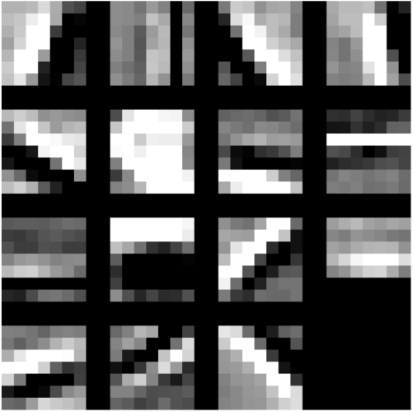

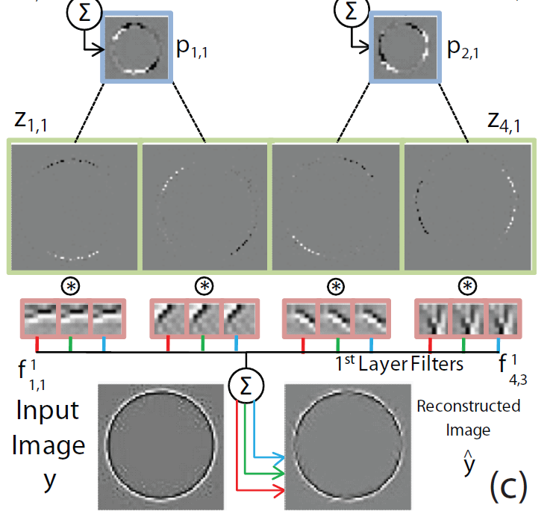
Example Feature Learning Architectures
Pixels /
Features
Filter with Dictionary
(patch/tiled/convolutional)
+ Non-linearity
Normalization between feature responses
(Group)
Sparsity
Max
/
Softmax
Local Contrast Normalization (Subtractive & Divisive)
Not an exact separation
Spatial/Feature
(Sum or Max)
Features
Notes:
Selection instead of normalization?

Slide 19
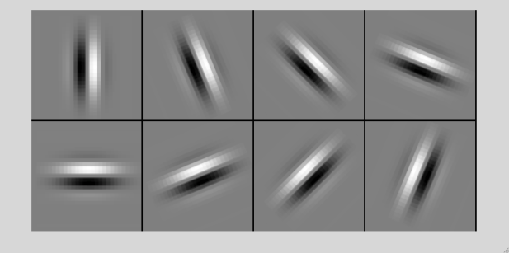
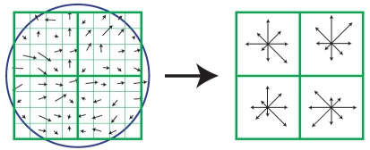
SIFT Descriptor
Image Pixels
Apply Gabor filters
Spatial pool
(Sum)
Feature Vector
Normalize to unit length
Notes:
Note pooling is across space, not across Gabor channel
Normalization is really nonlinear (small elements not rescaled)

Slide 20
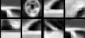
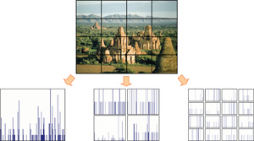
Spatial Pyramid Matching
Lazebnik, Schmid, Ponce [CVPR 2006]
SIFT Features
Filter with Visual Words
Max
Multi-scale spatial pool
(Sum)
Classifier
Notes:
Non-maximal suppression across VW. Like an L-Inf normalization
Max = k-means

Slide 21
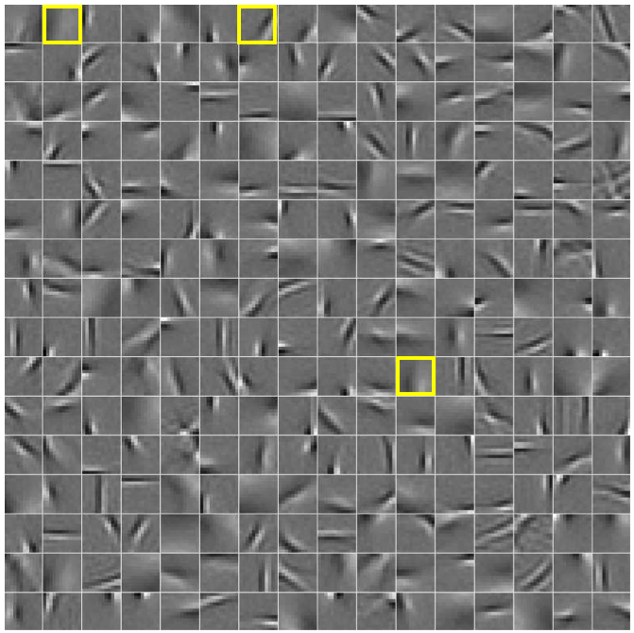
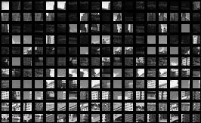
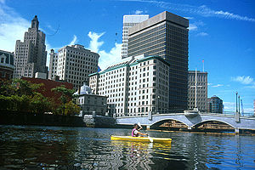
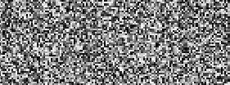
Filtering
Patch
Image as a set of patches
Filters
#patches
Input
#filters

Slide 22
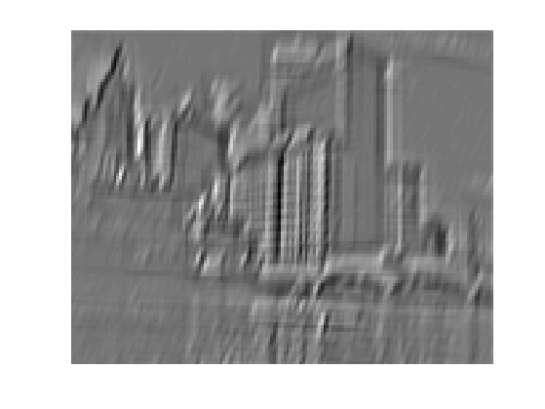
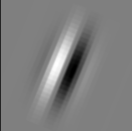
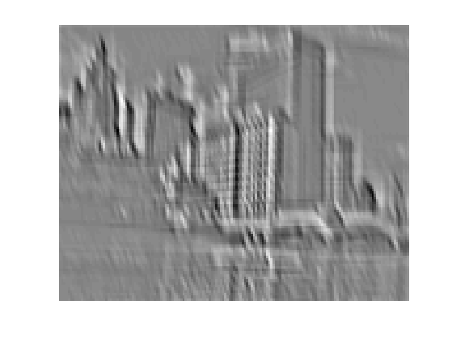
Filtering
Convolutional
Translation equivariance
Tied filter weights
(same at each position → few parameters)
...
Input
Feature Map

Slide 23
Translation Equivariance
Input translation → translation of features
Fewer filters needed: no translated replications
But still need to cover orientation/frequency
Patch-based
Convolutional

Slide 24
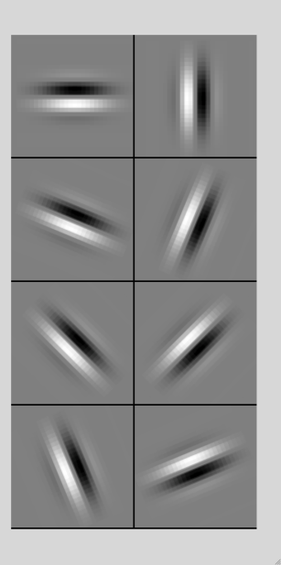
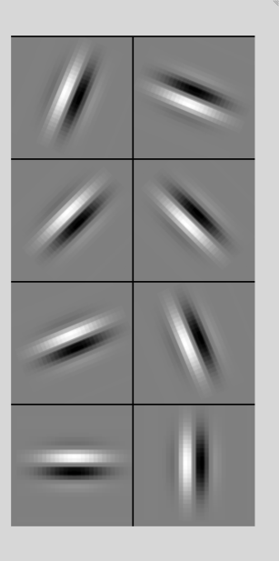
Filtering
Tiled
Filters repeat every n
More filters than convolution for given # features
Input
Filters
Feature maps

Slide 25
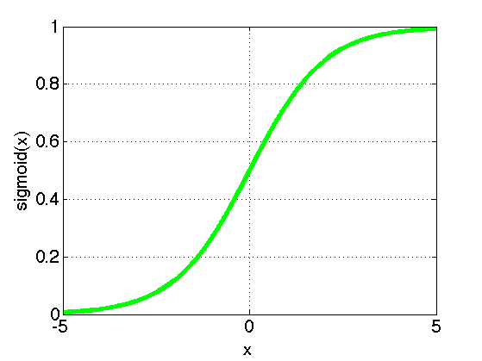
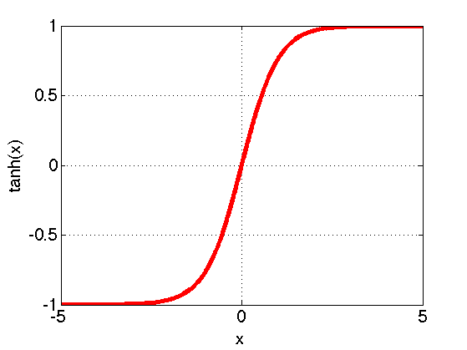
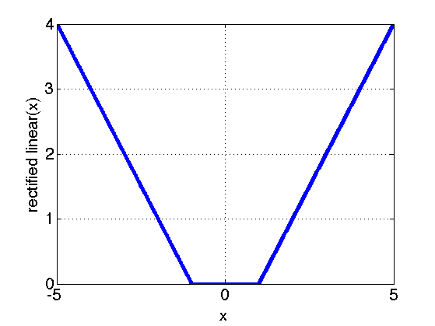
Filtering
Non-linearity
Per-feature independent
Tanh
Sigmoid: 1/(1+exp(-x))
Rectified linear

Slide 26
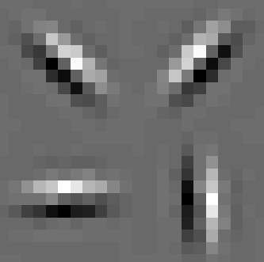
Normalization
Contrast normalization
See Divisive Normalization in Neuroscience
Input
Filters

Slide 27
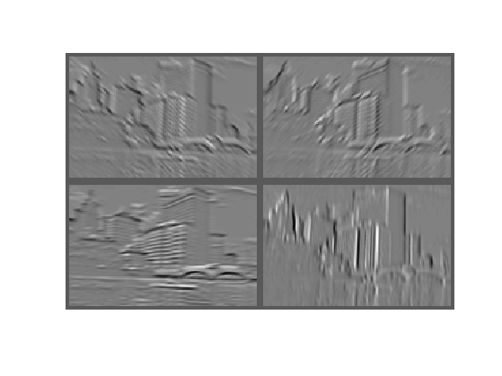
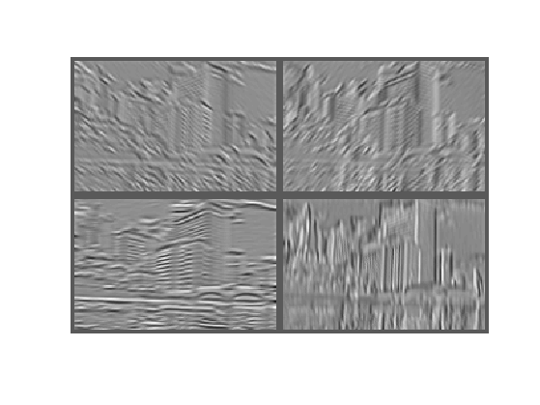
Normalization
Contrast normalization (across feature maps)
Local mean = 0, local std. = 1, “Local” → 7x7 Gaussian
Equalizes the features maps
Feature Maps After Contrast Normalization
Feature Maps

Slide 28
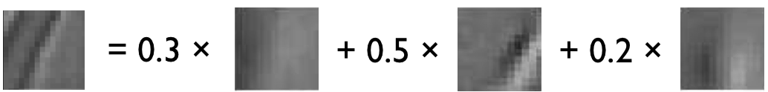
Normalization
Sparsity
Constrain L₀ or L₁ norm of features
Iterate with filtering operation (ISTA sparse coding)
Input Patch
Filters
Features
Sparse Coding
K-means

Slide 29
Role of Normalization
Induces local competition between features to explain input
“Explaining away” in graphical models
Just like top-down models
But more local mechanism
Filtering alone cannot do this!
|.|₁
|.|₁
|.|₁
|.|₁
Convolution
Filters
Example:
Convolutional Sparse Coding
from Zeiler et al. [CVPR’10/ICCV’11]

Slide 30
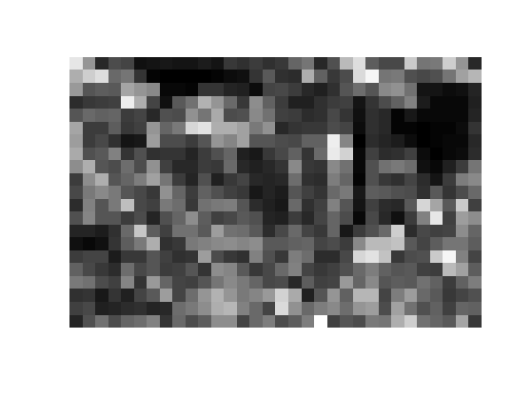
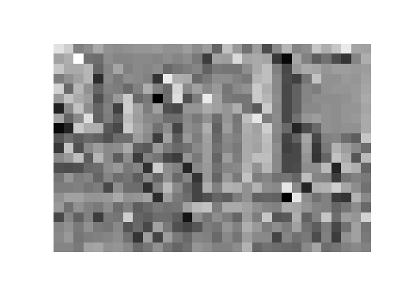
Pooling
Spatial Pooling
Non-overlapping / overlapping regions
Sum or max
Boureau et al. ICML’10 for theoretical analysis
Max
Sum

Slide 31
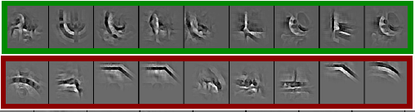
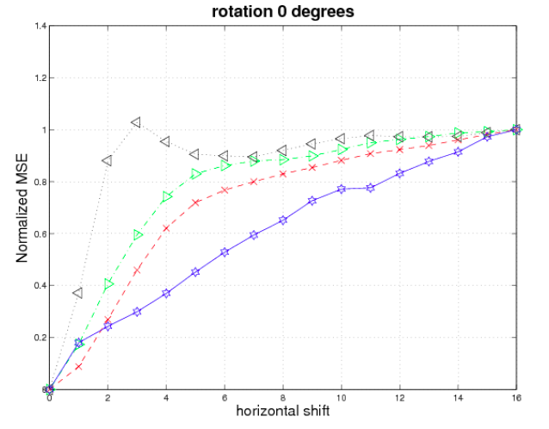
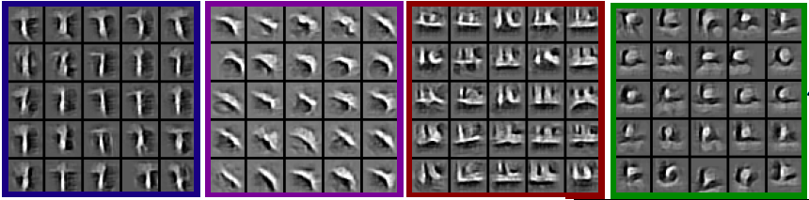
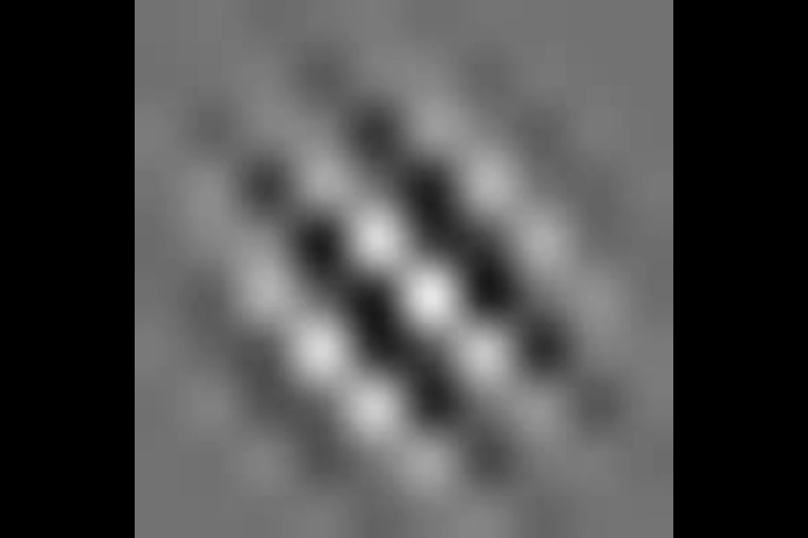

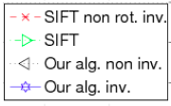
Role of Pooling
Q.V. Le, J. Ngiam, Z. Chen, D. Chia, P. Koh, A.Y. Ng
Tiled Convolutional Neural Networks. NIPS, 2010
Spatial pooling
Invariance to small transformations
Larger receptive fields (see more of input)
Visualization technique from [Le et al. NIPS’10]:
Change in descriptor
[Kavukcuoglu et al., ‘09]
Videos from: http://ai.stanford.edu/~quocle/TCNNweb
Zeiler, Taylor, Fergus [ICCV 2011]
Translation
Notes:
Graph not clear. Explain better. Y-axis is change in value

Slide 32
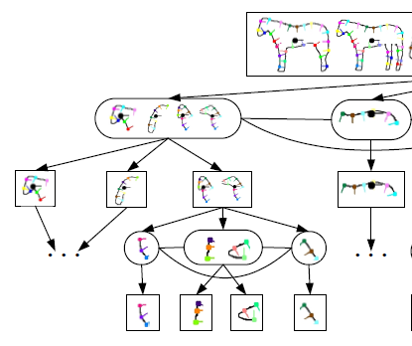
Role of Pooling
Pooling across feature groups
Additional form of inter-feature competition
Gives AND/OR type behavior via (sum / max)
Compositional models of Zhu, Yuille
[Zeiler et al., ‘11]
Chen, Zhu, Lin, Yuille, Zhang [NIPS 2007]
Notes:
Mention Leonardis & Fidler paper

Slide 33
Unsupervised Learning
Only have class labels at top layer
Intermediate layers have to be trained unsupervised
Reconstruct input
1st layer: image
Subsequent layers: features from layer beneath
Need constraint to avoid learning identity
Notes:
Too far for labels to trickle down (vanishing gradients)
Only information from layer below.
Input is supervision.

Slide 34
Auto-Encoder
Output Features
Feed-back / generative / top-down
path
Decoder
e.g.
Encoder
Feed-forward / bottom-up path
Input (Image/ Features)

Slide 35
Auto-Encoder Example 1
Restricted Boltzmann Machine [Hinton ’02]
(Binary) Features z
Decoder filters W^{T}
Sigmoid function σ(.)
σ(W^{T}z)
e.g.
σ(Wx)
Encoder filters W
Sigmoid function σ(.)
(Binary) Input x

Slide 36
Auto-Encoder Example 2
Predictive Sparse Decomposition [Ranzato et al., ‘07]
Sparse Features z
L₁ Sparsity
Dz
e.g.
σ(Wx)
Encoder filters W
Sigmoid function σ(.)
Decoder filters D
Input Patch x
Notes:
Add overall energy

Slide 37

Auto-Encoder Example 2
Predictive Sparse Decomposition [Kavukcuoglu et al., ‘09]
Sparse Features z
L₁ Sparsity
Encoder filters W
Sigmoid function σ(.)
Dz
σ(Wx)
e.g.
Decoder filters D
Input Patch x
Training

Slide 38
Taxonomy of Approaches
Autoencoder (most Deep Learning methods)
RBMs / DBMs [Lee / Salakhutdinov]
Denoising autoencoders [Ranzato]
Predictive sparse decomposition [Ranzato]
Decoder-only
Sparse coding [Yu]
Deconvolutional Nets [Yu]
Encoder-only
Neural nets (supervised) [Ranzato]

Slide 39
Stacked Auto-Encoders
Class label
Decoder
Encoder
Features
e.g.
Decoder
Encoder
Features
Decoder
Encoder
[Hinton & Salakhutdinov Science ‘06]
Input Image

Slide 40
At Test Time
Class label
Remove decoders
Use feed-forward path
Gives standard(Convolutional) Neural Network
Can fine-tune with backprop
Encoder
Features
e.g.
Encoder
Features
Encoder
[Hinton & Salakhutdinov Science ‘06]
Input Image

Slide 41
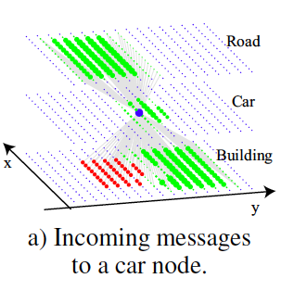
Information Flow in Vision Models
Class label
Top-down (TD) vs bottom-up (BU)
In Vision typically: BU appearance + TD shape
Example 1: MRF’s
Example 2: Parts & Structure models
Context models
E.g. Torralba et al. NIPS’05
Top
Down
Bottom Up
Input Image
Notes:
Not separate operations
Do it at the same

Slide 42
Deep Boltzmann Machines
Both pathways use at train & test time
TD modulation
of BU features
Class label
Salakhutdinov & Hinton
AISTATS’09
Decoder
Encoder
See also:
Eslami et al. CVPR’12 Oral on Monday
Features
e.g.
Decoder
Encoder
Features
Decoder
Encoder
Input Image
Notes:
Chris williams oral link

Slide 43

Why is Top-Down important?
Example: Occlusion
BU alone can’t separate sofa from cabinet
Need TD information to focus on relevant part of region
Notes:
Occlusion mask: bootom right quad for sofa interpretation
Can’t decide locally
If you knew solution, would know what features to extract.

Slide 44
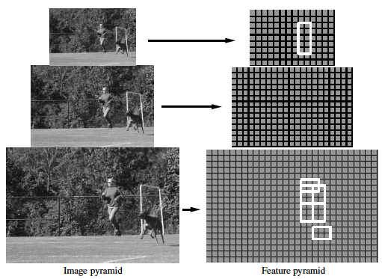
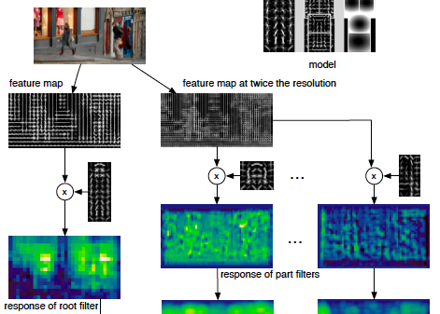
Multi-Scale Models
E.g. Deformable Parts Model
[Felzenszwalb et al. PAMI’10], [Zhu et al. CVPR’10]
Note: Shape part is hierarchical
Root
Parts
Sub- parts
HOG Pyramid
[Felzenszwalb et al. PAMI’10]

Slide 45
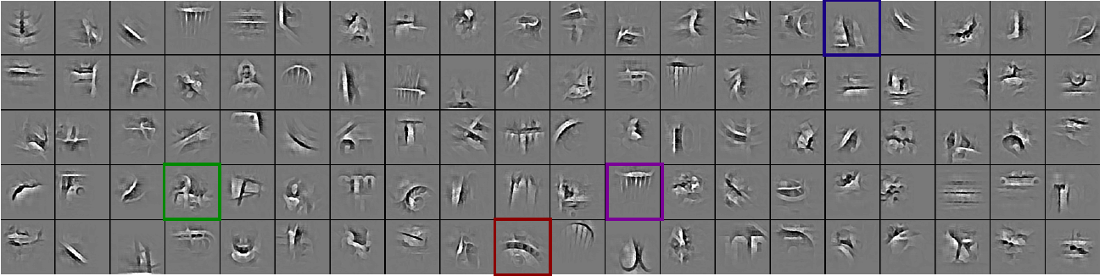
Hierarchical Model
Most Deep Learning models are hierarchical
Input Image/ Features
Input Image/ Features
[Zeiler et al. ICCV’11]
Notes:
DPM is shape hierarchical
HOG templates

Slide 46
Multi-scale vs Hierarchical
Root
Parts
Sub- parts
Feature Pyramid
Input Image/ Features
Appearance term of each part is independent of others
Parts at one layer of hierarchy depend on others
Notes:
DPM is shape hierarchical
HOG templates

Slide 47
Structure Spectrum
Learn everything
Homogenous architecture
Same for all modalities
Only concession topology (2D vs 1D)
Build vision knowledge into structure
Shape, occlusion etc.
Stochastic grammars, parts and structure models
How much learning?
Notes:
Song Chun ‘s clock

Slide 48
Structure Spectrum
Learn
Stochastic Grammar Models
Set of production rules for objects
Zhu & Mumford, Stochastic Grammar of Images, F&T 2006
Hand specify
[S.C. Zhu et al.]

Slide 49
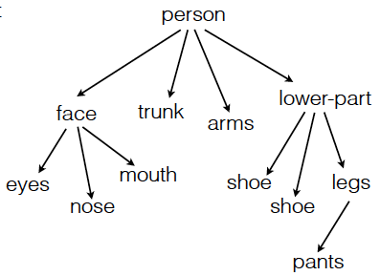
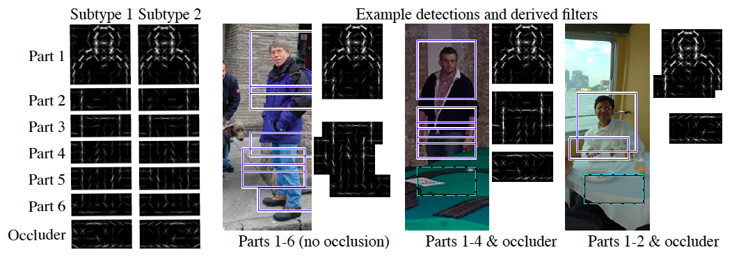

Structure Spectrum
Learn
R. Girshick, P. Felzenszwalb, D. McAllester, Object Detection with Grammar Models, NIPS 2011
Learn local appearance & shape
Hand specify

Slide 50


Structure Spectrum
Learn
Parts and Structure models
Defined connectivity graph
Learn appearance / relative position
Hand specify
[Felzenszwalb & Huttenlocher CVPR’00 ]
[Fischler and R. Elschlager 1973 ]

Slide 51

Structure Spectrum
Learn
Fidler et al. ECCV’10
Fidler & Leonardis CVPR’07
Hierarchy of parts and structure models
Hand specify

Slide 52

Structure Spectrum
Learn
Leo Zhu, Yuanhao Chen, Alan Yuille & collaborators
Recursive composition, AND/OR graph
Learn # units at layer
Hand specify

Slide 53


Structure Spectrum
Learn
Transforming Auto-Encoders
[Hinton et al. ICANN’11]
Deconvolutional Networks
[Zeiler et al. ICCV’11]
Explicit representation of what/where
Hand specify

Slide 54

Structure Spectrum
Learn
Neural Nets / Auto-encoders
Dedicated pooling / LCN layers
No separation of what/where
Modality independent (e.g. speech, images)
[Le et al., ICML’12]
Hand specify

Slide 55

Structure Spectrum
Learn
Boltzmann Machines
Homogenous architecture
No separation of what/where
Modality independent (e.g. speech, images)
Hand specify
[Salakhutdinov & Hinton AISTATS’09]

Slide 56
Performance of Deep Learning
State-of-the-art on some (simpler) datasets
Classification
ILSVRC 2010 (~1.4M images)
NEC/UIUC Winners (Sparse coding)
Full ImageNet (~16M images @ 2011)
Le et al. ICML’12 15.8% (vs 9.3% Weston et al.)
Video
Holywood 2 (Action Recognition): Le et al. CVPR’11 53.3% (vs 50.9%)
Detection
INRIA Pedestrians: Sermanet & LeCun (6.6% vs 8.6% miss rate @ 1FPPI)
Not yet state-of-the-art on more challenging ones (e.g. PASCAL VOC Detection)

Slide 57
Summary
Unsupervised Learning of Feature Hierarchies
Detailed explanation in following talks
Showing promise on vision benchmarks
Success in other modalities (speech, text)
But few Deep Learning papers at CVPR!

Slide 58
Further Resources
http://deeplearning.net/
http://www.cs.toronto.edu/~hinton/csc2515/deeprefs.html
http://www.cs.toronto.edu/~hinton/MatlabForSciencePaper.html
NIPS 2011 workshop on Deep Learning and Unsupervised Feature Learning
http://deeplearningworkshopnips2011.wordpress.com/
Torch5 http://torch5.sourceforge.net/

Slide 60
References
[Slide 5]
P. Felzenszwalb, R. Girshick, D. McAllester, D. Ramanan, Object Detection with Discriminatively Trained Part Based Models,IEEE Transactions on Pattern Analysis and Machine Intelligence, Vol. 32, No. 9, September 2010
Zheng Song*, Qiang Chen*, Zhongyang Huang, Yang Hua, and Shuicheng Yan. Con­tex­tu­al­iz­ing Ob­ject De­tec­tion and Clas­si­fi­ca­tion. In CVPR'11. (* in­di­cates equal con­tri­bu­tion) [No. 1 per­for­mance in VOC'10 clas­si­fi­ca­tion task]
[Slide 6]
Finding the Weakest Link in Person Detectors, D. Parikh, and C. L. Zitnick, CVPR, 2011.
[Slide 7]
Gehler and Nowozin, On Feature Combination for Multiclass Object Classification, ICCV’09
[Slide 8]
http://www.amazon.com/Vision-David-Marr/dp/0716712849
[Slide 10]
Yoshua Bengio and Yann LeCun: Scaling learning algorithms towards AI, in Bottou, L. and Chapelle, O. and DeCoste, D. and Weston, J. (Eds), Large-Scale Kernel Machines, MIT Press, 2007

Slide 61
References
[Slide 11]
S. Lazebnik, C. Schmid, and J. Ponce, Beyond Bags of Features: Spatial Pyramid Matching for Recognizing Natural Scene Categories, CVPR 2006
[Slide 12]
Christoph H. Lampert, Hannes Nickisch, Stefan Harmeling: "Learning To Detect Unseen Object Classes by Between-Class Attribute Transfer", IEEE Computer Vision and Pattern Recognition (CVPR), Miami, FL, 2009
[Slide 14] Riesenhuber, M. & Poggio, T. (1999). Hierarchical Models of Object Recognition in Cortex. Nature Neuroscience 2: 1019-1025.
http://www.scholarpedia.org/article/Neocognitron
K. Fukushima: "Neocognitron: A self-organizing neural network model for a mechanism of pattern recognition unaffected by shift in position", Biological Cybernetics, 36[4], pp. 193-202 (April 1980).
Y. LeCun, L. Bottou, Y. Bengio and P. Haffner: Gradient-Based Learning Applied to Document Recognition, Proceedings of the IEEE, 86(11):2278-2324, November 1998

Slide 62
References
[Slide 30]
Y-Lan Boureau, Jean Ponce, and Yann LeCun, A theoretical analysis of feature pooling in vision algorithms, Proc. International Conference on Machine learning (ICML'10), 2010
[Slide 31]
Q.V. Le, J. Ngiam, Z. Chen, D. Chia, P. Koh, A.Y. Ng , Tiled Convolutional Neural Networks. NIPS, 2010
http://ai.stanford.edu/~quocle/TCNNweb
Matthew D. Zeiler, Graham W. Taylor, and Rob Fergus, Adaptive Deconvolutional Networks for Mid and High Level Feature Learning, International Conference on Computer Vision(November 6-13, 2011)
[Slide 32]
Yuanhao Chen, Long Zhu, Chenxi Lin, Alan Yuille, Hongjiang Zhang. Rapid Inference on a Novel AND/OR graph for Object Detection, Segmentation and Parsing. NIPS 2007.

Slide 63
References
[Slide 35]
P. Smolensky, Parallel Distributed Processing: Volume 1: Foundations, D. E. Rumelhart, J. L. McClelland, Eds. (MIT Press, Cambridge, 1986), pp. 194–281.
G. E. Hinton, Neural Comput. 14, 1711 (2002).
[Slide 36]
M. Ranzato, Y. Boureau, Y. LeCun. "Sparse Feature Learning for Deep Belief Networks". Advances in Neural Information Processing Systems 20 (NIPS 2007).
[Slide 39]
Hinton, G. E. and Salakhutdinov, R. R., Reducing the dimensionality of data with neural networks. Science, Vol. 313. no. 5786, pp. 504 - 507, 28 July 2006.
[Slide 41]
A. Torralba, K. P. Murphy and W. T. Freeman, Contextual Models for Object Detection using Boosted Random Fields, Adv. in Neural Information Processing Systems 17 (NIPS), pp. 1401-1408, 2005.

Slide 64
References
[Slide 42]
Ruslan Salakhutdinov and Geoffrey Hinton, Deep Boltzmann Machines, 12th International Conference on Artificial Intelligence and Statistics (2009).
[Slide 44]
P. Felzenszwalb, R. Girshick, D. McAllester, D. Ramanan, Object Detection with Discriminatively Trained Part Based Models,IEEE Transactions on Pattern Analysis and Machine Intelligence, Vol. 32, No. 9, September 2010
Long Zhu, Yuanhao Chen, Alan Yuille, William Freeman. Latent Hierarchical Structural Learning for Object Detection. CVPR 2010.
[Slide 45]
Matthew D. Zeiler, Graham W. Taylor, and Rob Fergus, Adaptive Deconvolutional Networks for Mid and High Level Feature Learning, International Conference on Computer Vision(November 6-13, 2011)

Slide 65
References
[Slide 48]
S.C. Zhu and D. Mumford, A Stochastic Grammar of Images, Foundations and Trends in Computer Graphics and Vision, Vol.2, No.4, pp 259-362, 2006.
[Slide 49]
R. Girshick, P. Felzenszwalb, D. McAllester, Object Detection with Grammar Models, NIPS 2011
[Slide 50]
P. Felzenszwalb, D. Huttenlocher, Pictorial Structures for Object Recognition, International Journal of Computer Vision, Vol. 61, No. 1, January 2005
M. Fischler and R. Elschlager. The Representation and Matching of Pictoral Structures. (1973)
[Slide 51]
S. Fidler, M. Boben, A. Leonardis. A coarse-to-fine Taxonomy of Constellations for Fast Multi-class Object Detection. ECCV 2010.
S. Fidler and A. Leonardis. Towards Scalable Representations of Object Categories: Learning a Hierarchy of Parts. CVPR 2007.

Slide 66
References
[Slide 52]
Long Zhu, Chenxi Lin, Haoda Huang, Yuanhao Chen, Alan Yuille. Unsupervised Structure Learning: Hierarchical Recursive Composition, Suspicious Coincidence and Competitive Exclusion. ECCV 2008.
[Slide 53]
Hinton, G. E., Krizhevsky, A. and Wang, S, Transforming Auto-encoders. ICANN-11: International Conference on Artificial Neural Networks, 2011
Matthew D. Zeiler, Graham W. Taylor, and Rob Fergus, Adaptive Deconvolutional Networks for Mid and High Level Feature Learning, International Conference on Computer Vision(November 6-13, 2011)
[Slide 54]
Q.V. Le, M.A. Ranzato, R. Monga, M. Devin, K. Chen, G.S. Corrado, J. Dean, A.Y. Ng., Building high-level features using large scale unsupervised learning. ICML, 2012.
[Slide 55]
Ruslan Salakhutdinov and Geoffrey Hinton, Deep Boltzmann Machines, 12th International Conference on Artificial Intelligence and Statistics (2009).

Slide 67
References
[Slide 56]
http://www.image-net.org/challenges/LSVRC/2010/
Q.V. Le, M.A. Ranzato, R. Monga, M. Devin, K. Chen, G.S. Corrado, J. Dean, A.Y. Ng., Building high-level features using large scale unsupervised learning. ICML, 2012.
Q.V. Le, W.Y. Zou, S.Y. Yeung, A.Y. Ng., Learning hierarchical spatio-temporal features for action recognition with independent subspace analysis, CVPR 2011

